Slide 1

ESMHA Annual General Meeting
June 13, 2021

Slide 2
Agenda
Introduction & Call to Order;
Approval of Minutes from 2020 AGM;
Reports:
  President;
  Divisional Coordinators:
    U7 (IP);
    U9 (Novice);
    U11 (Atom);
    U13 (Peewee);
    U15 (Bantam);
    U18 (Midget);
Reports Continued:
  Female Hockey Coordinator;
  Treasurer;
  Registrar;
  Ice Coordinator;
  Equipment Coordinator;
  Coaching Coordinator;
  Development Coordinator;
  Budget Coordinator;
Q&A;
Elections:
  Vice President;
  Treasurer;
  Ice Coordinator;
  Female Hockey Coordinator;
  Recreational Coordinator;
  Coach Coordinator;
  U7 (IP) Coordinator;
  U9 (Novice) Coordinator;
  U11 (Atom) Coordinator;
  U13 (Peewee) Coordinator;
  U15 (Bantam) Coordinator;
  U18 (Midget) Coordinator;
  Association COVID Rep;
Adjournment;

Slide 3
Introduction & Call to Order
Unfortunately all participants will be on mute for the duration of the meeting unless required by elections or to produce answers to the Q&A.
Send Questions at any time during the meeting through the chat feature. We will do our best to answer the questions submitted in the time permitted. If you have a question that didn’t get answered during the AGM, you can contact the appropriate (new) executive member; contact information is listed on our website.

Slide 4
Approval of Minutes from 2019 AGM
Date: August 11th, 2020, 7:00 p.m.
Location: Online Zoom Conference;
ESMHA 2020 AGM Meeting Minutes:
http://esmha.goalline.ca/files/draft_esmha_agm_minutes__aug_11,_2020.pdf
ESMHA 2020 AGM Reports and Financials:
http://esmha.goalline.ca/files/esmha_agm_11_8_2020_v32.pdf

Slide 5
Reports: President
President: Paul Anderson
2020/21 ESMHA AGM President Report
In March of 2020 Hockey Canada, Hockey Nova Scotia, and Eastern Shore Minor Hockey Association ended their seasons abruptly due to the Covid 19 Pandemic. ESMHA executive met virtually on many different occasions working to close out the 2019/20 season and prepare for the 2020/21 season. Our executive team spent countless hours planning and preparing for an unconventional year. Safety for all was at the forefront as we worked with the Hockey Nova Scotia Rebound Plan, Nova Scotia Public Health protocols and restrictions, Halifax Regional Municipality guidelines and facility plans. There were many logistical and financial challenges. The executive understood from the beginning that it was going to take a flexible and open plan to operate and complete the 2020/21 season. Our dedicated volunteers and membership worked together through the many changes and obstacles. It took the entire hockey community to make this season possible. There were many highlights from this past year and plenty of positive feedback. Like any season there were learning curves and growing pains and areas for improvement. Our goals have not wavered and we will continue to strive for growth and development of our association and create opportunities for a positive hockey experience in our community.
As we close out this extraordinary season I want to Thank all front line workers, essential workers, and healthcare professionals for their daily sacrifice and care. I wish you all a happy and healthy summer and look forward to the 2021/22 Eastern Shore Mariners hockey season.
Sincerely,
Paul Anderson
ESMHA President

Slide 6
Reports: U7 (IP)
U7 Coordinator: Jenn Day
We had 55 players this season, and some great reliable volunteers on all teams:
    6 year old’s had 2 teams, one having 14 players and the other having 15 players.
    5 year old’s had 1 team of 14 players.
    4 year old’s had 1 team of 12 players.
Each team had 2 ice times a week, once the covid restrictions came into place they went to 1 practice a week.
There were a few kids who withdrew after the covid restrictions tightened and the parents were no longer allowed in the rink, one child was moved from the 4 year old’s to 5 year old’s and she was super advanced.
With the help of parents, Rick Bennett, and Rick Rector, we gave all the U7 teams a mini jamboree (within their team). They came onto the ice with the lights, music, and fog, they were each given their medals, as well as had a bag with some swag in it.
I feel for such a unknown hockey season, things went pretty good, kids and parents were pretty understanding and most seemed to adapt well to the changes.
Jenn Day
U7 Coordinator

Slide 7
Reports: U9 (Novice)
U9 Coordinator: Rene Campbell-Poirier
TBD
Update as Required

Slide 8
Reports: U11 (Atom)
U11 Coordinator: Troy Nickerson
U11C Black – 12 wins, 7 loses, 4 ties→ finished regular season in 6th
U11C Gold – 3 wins, 15 loses, 4 ties → finished regular season in 11th
U11B – 5 wins, 5 loses, 0 ties→ finished regular season in 6th
All players made the most of the year that we were faced with. They all played hard. Coaches, managers and covid reps all stepped up to make the season great! THANK YOU!
U11B Highlights: It was a great season for our U11B team and families. Although it was a very different and challenging year with Covid our team was flexible and understanding and made the best of it. Our group was extremely dedicated and we had perfect attendance for our 27 games this season. We stuck with our practice and financial plan of one full ice practice a week and utilized our defensive and Offensive Coaching group every practice. Our Goalie Coach was important and made a big a impact on the development of our Goalie. Our groups dedication and hard work showed as we improved as the season went on finishing first overall and ending with a semi final loss in the CMHF championship weekend.
Our biggest highlight this season was having our Assistant Captain Finnley Greenland join us on the ice at the end of the season. I believe most know Finnley's story and the obstacles he has faced. Seeing him step on the ice for the first time since his accident one year ago was very emotional and exciting. Finnley has been a big part of our team this season. It was amazing to be a part of this group who loved and supported there friend and teammate. It was bigger then hockey

Slide 9
Reports: U13 (Peewee)
U13 Coordinator: Melissa Arnold
U13 C - The year went well for the Peewee House League, all the kids played well and interacted great. It was a little hard getting our bearings when the season shut down and reopened but we managed and got through it. We had 16 players counting the goalie and with all sixteen there was lots of talent that came out on the ice, the kids seemed very happy to play hockey this year. I feel that hockey helped the kids mentally this year due to the unique situation that we are in. My volunteers that helped out with making this season work were Julie Martin (Manager) Tammy Prior ( Safety Rep) Adam Haverstock (Coach) Josh Norwood (Coach) and Bob Thomas ( Coach) And Trish Stallaert (Treasurer). It was a great year and i was glad to have the opportunity to coach a great bunch of kids. - Coach Garnet
U13 B - We had a team of 16 this year. 14 players and 2 goalies. We won 2 games, lost seven and tied one in the regular season and finished second last. Overall the season went well considering. The kids got to play and have fun, which was most important. Overall was a great season for the kids.
U13 AA - 14 skaters, 2 goalies, 5 coaches. Record: 10 wins, 12 losses, 4 ties. Best rival was Cole Harbour; our players, coaches and parents always looked forward to play them. Our record was 4 wins, 2 losses, and 1 tie with them. It was a different season but our players worked very hard and played as a team.
U13 AAA – The season was great! We had a team of 17 amazing kids form Eastern Shore, Cole Harbour, Bedford, and Acadia. As well, we had 3 awesome coaches! Despite the shut downs form COVID, the team really came together, played hard and had a wonderful season!
U13 AAA won the HNS Fred fox Team of the year award

Slide 10
Reports: U15 (Bantam)
U15 Coordinator: Tracey Avery
U15 had a challenging year with respect to numbers.
U15 C – 9 skaters and 1 goalie, the team suffered a season of loss and frustration with a small bench. The team had 22 losses and 0 wins. The exhaustion the players felt was overwhelming by both players and parents.
U15 B – 11 skaters and 1 goalie. They too had a difficult season affected by a small bench resulting in only 2 wins and exhausted players by the end of the 2nd period every game. The team had 19 losses and 2 wins. “The team seemed to hold it together pretty good until part way through the 2nd period, I feel that’s when the exhaustion of having such a small team hit them.”
U15 A – 13 skaters and 2 goalies. Overall 9 wins, 15 losses and 4 ties. Overall it was a challenging season dealing with COVID and the stoppage and lack of travel and tournaments. The kids really seemed to miss out with this and the team unity/bonding from these activities. Parents felt disconnected from the season overall as well.

Slide 11
Reports: U18 (Midget)
U18 Coordinator: Shannon Karsten
U18 Season 2020-21
36 registered
14 left to play High School
6 released to play elsewhere
1 quit
15 played U18C
U18A was not offered this year due to our lower numbers.
The U18C Mariners had a bit of a challenging start to due player movement. They had a dedicated team, and great coaches. Players had perfect attendance at games and practices. Game play was kept clean and players were held accountable for their actions on and off the ice.
We are hoping this has a positive effect on the stigmatism that surrounded the U18C team for years past and hopefully will encourage players to play hockey again knowing they can have a successful season at any level.

Slide 12
Reports: Female Hockey Coordinator
Female Hockey Coordinator: Paul Anderson
TBD
Update as Required

Slide 13
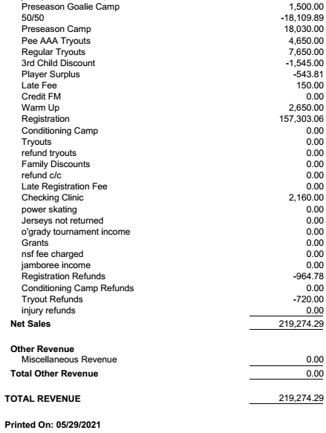
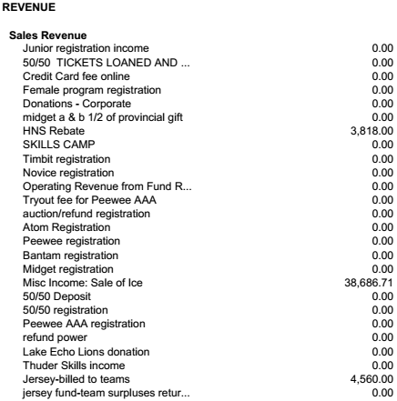
Reports: Treasurer
Treasurer: Lynn Humphreys

Slide 14
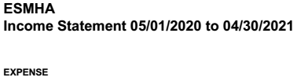
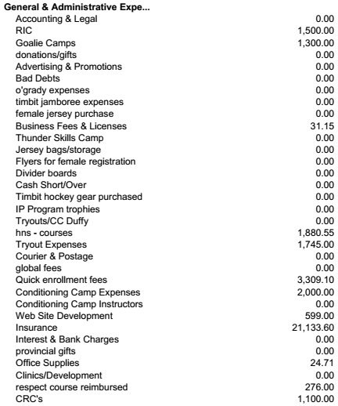
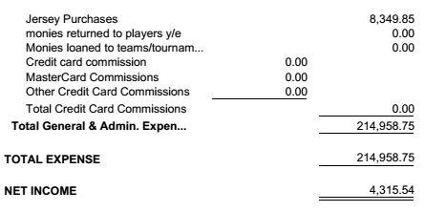
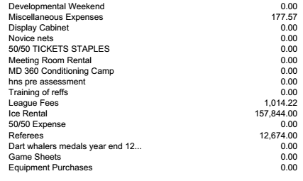
Reports: Treasurer
Treasurer: Lynn Humphreys

Slide 15
Reports: Registrar
Registrar: Janie Conrad
 | Pre-Registered | Did not play full season with ESMHA | Played full Season
U7 | 58 |  | 58
U9 | 46 | 1 Quit | 45
U11 | 37 | 2 Town | 35
U13 | 70 | 2 Town, 1 Quit | 67
U15 | 46 | 4 Town, 2 Female, 1 Quit | 39
U18 | 36 | 14 High School, 6 Town, 3 Quit | 13
Totals | 293 | 14 High School, 2 Female, 14 Town, 6 Quit | 257
Division | Level
U7 | 4 groups
U9 | Adv, Int, Dev
U11 | B, C, C
U13 | AAA, AA, B, C
U15 | A, B, C
U18 | C
Total | 18 Teams

Slide 16
Reports: Ice Coordinator
Ice Coordinator: Gina Dunn
Ice Schedule Report 2020-21
This year was based on 16 weeks of regular ice.
It was stretched into 20 weeks.
ESMHA used approx. 33.5 hours a week for a total of 751.5 association hours for the year (725.5 Prime & 26 Non-Prime) We are by far the largest user of ice at ESRC. They were very flexible and accommodating this year. We were credited back any ice that was cancelled due to Provincial and HRM Covid restrictions.
Ice costs stayed the same this year: Cost of Ice Prime $210 and Non-Prime $165.
Total cost of ice this year was:
$166,800.00 – billed from ES Rink
- $9,210.00 – credits due to Covid cancelled ice
$157,590.00 - total paid
-$38, 686.70 – Ice sold to teams
$118.903.29 – expense of ice to association for 2020/21

Slide 17
Reports: Ice Coordinator
Ice Coordinator: Gina Dunn
Conditioning Camp Ice
Our rink only charged the association for on ice time despite the time gaps in between scheduled times.
September/October were skills camps
Tryouts Ice
Tryouts started late October.
Regular Season Ice
Started in November. Registration this year was based on 16 weeks of regular season. Practices included in registration are 1 shared 60-minute ice per week. There were lots of stoppages due to Covid regulations but despite that, we were able to stretch ice budget get 20 weeks in (until mid April).
Goalie Clinics
We held 7 regular goalie clinics for an ice cost of $1470
These are FREE to all ESMHA registered goalies. ESMHA is one of the only associations to offer FREE goalie development.
Checking Clinic
We held a checking clinic for ESMHA players who were interested and will be playing in U15 and U18 in 2021/22
We used 6 hours of ice for a cost of $1260
Recommendations Ice for 2021/22
Currently our registration covers 1 shared 60-minute practice per week for teams at the U11, U13, U15, U18 levels. Is this still what our membership wants? Cost analysis of potential changes (ie. Automatically for all teams/certain teams? Included in registration? Player fees? Fundraised – team bills? etc). The above extra ice costs would give a general indicator of potential increases.

Slide 18
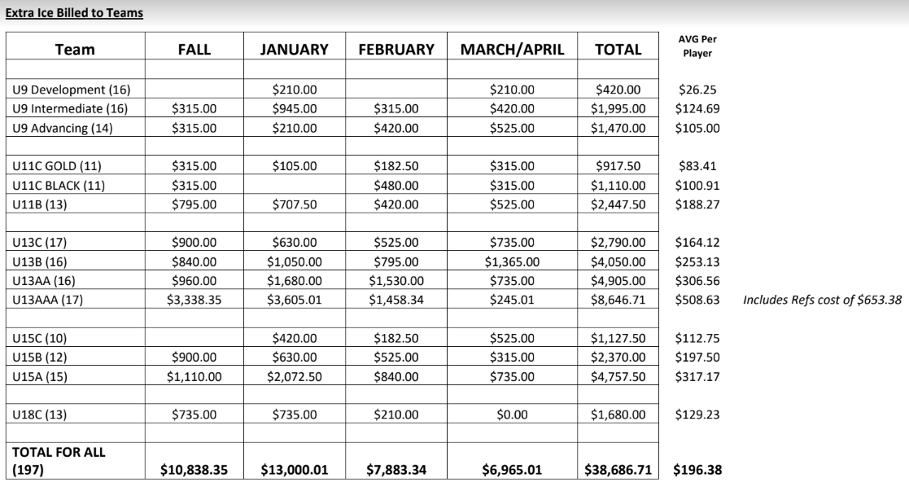
Reports: Ice Coordinator
Ice Coordinator: Gina Dunn

Slide 19
Reports: Equipment Coordinator
Equipment Coordinator: Tracey Julien-Baker
TBD
Update as Required

Slide 20
Reports: Coaching Coordinator
Coaching Coordinator: Jason St-Hilarie
It was a smooth year, with the Delay in November it allowed us the extra time to make sure all coaches rec’d all of their required credentials.
Tryouts went well, started using an app called Team Genius, which allowed us to streamline the scoring process.
Used Independent Evaluators From the Jr Thunder & Jake Bullen’s Camp one of which was a Professional Scout for the Bathurst Titan.
Did not Use Tom Duffy which reduced our Try-Out Bill by 80%
Plan to form a Tryout Committee of 4 Executives and use 100 % Independent Evaluators for upcoming Tryouts this year ( if re-elected )
We did not have a Coaches Game this year due to COVID-19
Currently Planning to have the Coaches Hot Stove virtually in the upcoming weeks, to go over what we did good, what we need to improve, COVID-19 issues
Coaches evaluation was sent out and to date we have rec’d 61 responses in 3 Day

Slide 21
Reports: Development Coordinator
Development Coordinator: Jake Bullen
POWER SKATING: The 2020-2021 Power Skating Program was offered to players from U11 – U18, looking to develop their skating skills. It started September 19th and ran for six weeks. The following were the numbers that attended from each age: U11: 16, U13: 28, and U15/U18: 21. This program was designed to work on developing skating skills for all players, while also being comfortable doing so with a puck on their stick. The players were introduced to many new drills, but all seemed to enjoy and all improved as the sessions went on. The program was designed by Jake Bullen and Paul Anderson, and with the help of many great volunteers, this was a success for our players and association.
HIGH PERFORMANCE GAME READY: The 2020-2021 High Performance Game Ready sessions offered players the opportunity to engage in new, high-tempo, and game specific drills, to prepare them for the upcoming tryouts. Due to the COVID-19 restrictions, the numbers on-ice were small, but nonetheless, these sessions were well-received. The players adapted well to the new drills and many began to develop their in-game skills. The goal of this was to provide an opportunity for players to push themselves outside of their comfort zone and try “elite” level drills and skills. Thank you once again to the many volunteers who assisted with these practices and made it possible.
BODY CHECKING CLINIC: The 2020-2021 Body Checking Clinic had 33 players registered. Paul Anderson ran the off-ice instruction, while the on-ice was organized by Jake Bullen, with the assistance of ESMHA volunteers. The clinic focused on the purpose of body checking, key components of safety, and understanding the importance of angling. Overall, the players were engaged and demonstrated their understanding of the teaching points and they were all successful in demonstrating their on-ice ability to do so.

Slide 22
Reports: Development Coordinator
Development Coordinator: Jake Bullen
SKILL SESSIONS: ESMHA partnered with the Eastern Shore Thunder Jr. C to provide a U7 & U9 head start camp at the beginning of the season. This was once again a great success and a great opportunity for the young players to get to know our local junior hockey club. A big thank you goes to Gerald Williams for his dedication and willingness to invest in the partnership between ESMHA and the Junior Thunder! Finally, the ESMHA coaches provided skill sessions for players from U11-U18. These sessions are helpful for both our coaches and players to hone their skills with another opportunity to get on the ice.
Despite a very unprecedented season, we were very pleased with the development opportunities and registration numbers for all ESMHA events in 2020/2021. Our goal is to provide affordable opportunities for our players that offer them the chance to develop their skills while, more importantly, making it enjoyable for all involved. We hope that this upcoming season will be one with less restrictions which will allow us to offer more opportunities for all players, goalies, and age groups. I want to give a huge thank you to the ESMHA Executive and all the volunteers that assisted in making these opportunities available for our players during this tough season. I am looking forward to 2021-2022 and what we can accomplish together!
Thank You!
Jake Bullen,
ESMHA Player Development Co-Ordinator

Slide 23
Reports: Budget Coordinator
Budget Coordinator: Natalie Stevens
TBD
Update as Required

Slide 24
Q&A
Questions:
From membership in advance of meeting;
From the floor via chat;

Slide 25
Elections
Position | Nominee
Vice President | Andrew Lowery (Incumbent)
Treasurer | Natalie Stevens
Ice Coordinator | Gina Dunn (Incumbent)
Female Hockey Coordinator | Rebecca Warner
Recreational Coordinator | Alex Mitchell (Incumbent)
Coach Coordinator | Jason St-Hilaire (Incumbent)
Position | Nominee
U7 (IP) Coordinator | Jenn Day (Incumbent)
U9 (Novice) Coordinator | Rene Campbell-Poirier (Incumbent)
U11 (Atom) Coordinator | Troy Nickerson (Incumbent)
U13 (Peewee) Coordinator | Melissa Arnold (Incumbent)
U15 (Bantam) Coordinator | Melissa Arnold
U18 (Midget) Coordinator | Shannon Karsten (Incumbent)
Position | Nominee
Association COVID Rep | None

Slide 26
Adjournment
Thank you all!

